Slide 1

Working with AutoIT in selenium-Part 1

Slide 2
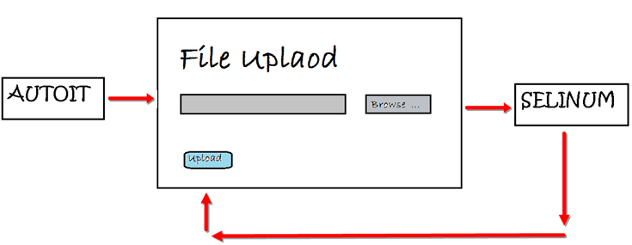
Introduction
AutoIT is used to handle window based activity which are not handled by Selenium.
AutoIT v3 is also freeware.
AutoIT uses a combination of mouse movement, keystrokes and window control manipulation to automate a task which is not possible by selenium webdriver.

Slide 3
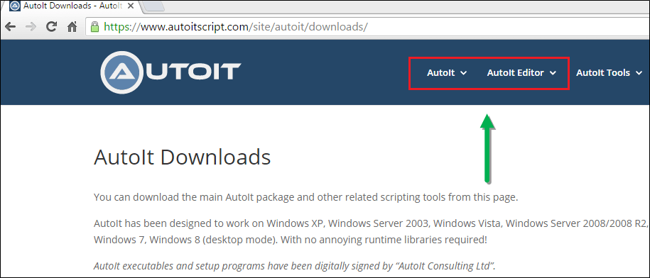
Download and Installation of AutoIT
Step 1) Go to this https://www.autoitscript.com/site/autoit/downloads
Step 2) Hover on 'Autoit' and 'Autoit Editor' dropdown.

Slide 4
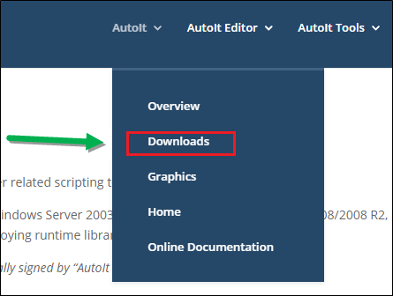
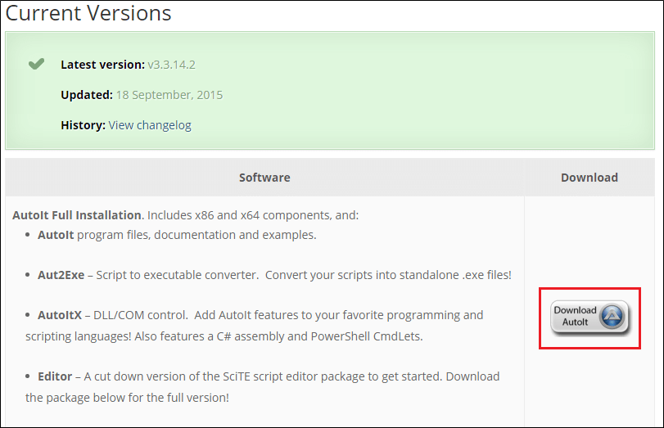
Step 3) Click on 'AutoIT' Downloads option.
Step 4) Download "Autoit" by clicking on 'Download Autoit' button .

Slide 5
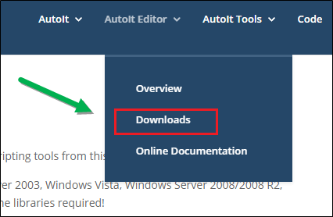
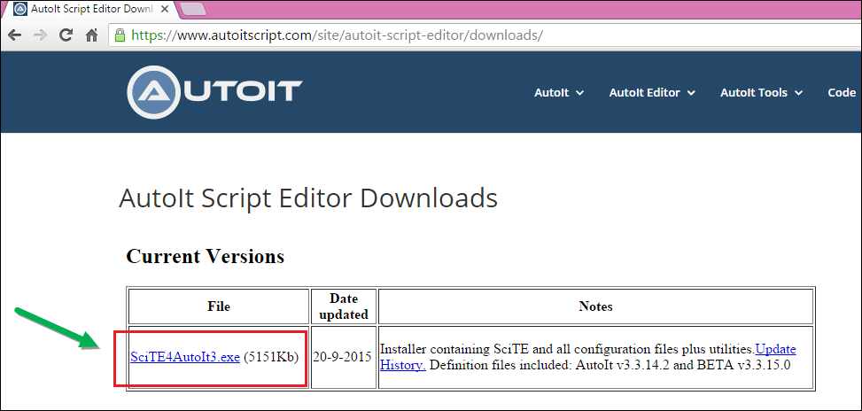
Step 5) Now download "Autoit editor" by clicking on 'Downloads' button .
Step 6) Click on the link as shown below.

Slide 6
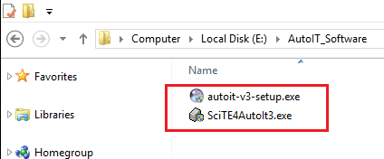
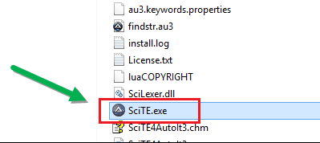
After download you will get two setup file as shown in below screen, first is AutoIt version 3setup and second is Scitautoit3 .
Step 6) For Installing AutoIT-Click on both AutoIT setup one by one .
Step 7) After successfully installation - open up AutoIT Editor.
Go to 'C:\Program Files (x86)\AutoIt3\SciTE'

Slide 7
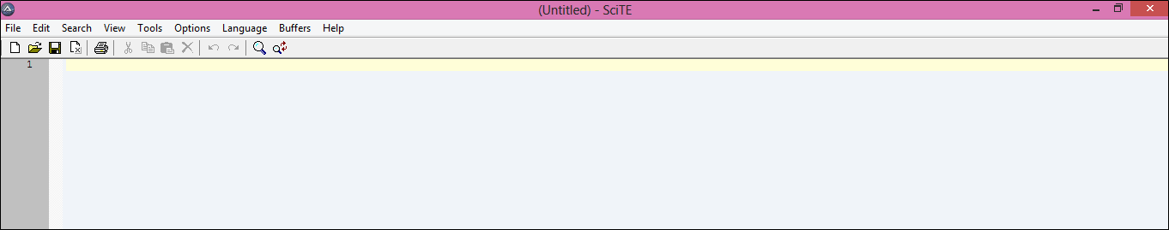

and click on 'SciTE.exe' file, the AutoIT editor opens as shown in below screen.
Step 8)Now opens element Identifier .
Go to 'C:\Program Files (x86)\AutoIt3 '

Slide 8
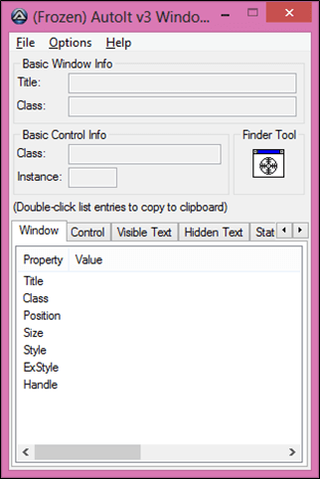
And click on 'Au3Info.exe' file, the element identifier opens as shown in below screen.

Slide 9
Covered Till Now
AutoIT is used to handle window based activity which are not handled by Selenium.
AutoIT v3 is also freeware.
AutoIT uses a combination of mouse movement, keystrokes and window control manipulation to automate a task which is not possible by selenium webdriver.
Download and installation of AutoIT.

Slide 10
Thanks

